Slide 1
Kalman Filter
Haiyue Wang

Slide 2
Outline
1. What is Kalman Filter
2. The meaning of details
2. The Domains using Kalma Filter
3. Three examples
4. Conclusion

Slide 3

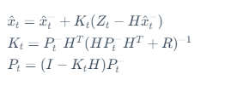
What is Kalman Filter
The Kalman Filter is a mathematical algorithm used for estimating and predicting the state of a dynamic system, particularly in the presence of noisy or uncertain data.
All the processes could be split into two parts.
Prediction
Update

Slide 4
The meaning of details
Getting a best estimation of state using multi iteration to approach real value.
How to do? All the processes could be split into two parts.
Prediction
Update

Slide 5
The Domain Usage of Kalman Filter
Aerospace and Navigation
Robotics
Finance and Economics:
Signal Processing
Weather Forecasting
Control Systems:
Communication Systems

Slide 6

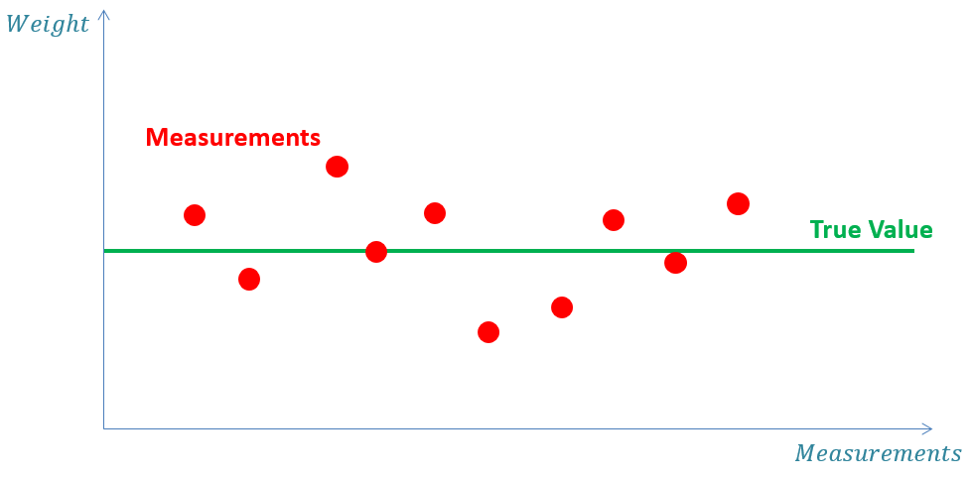
Example – Weight a Gold

Slide 7

Example – Weight a Gold

Slide 8
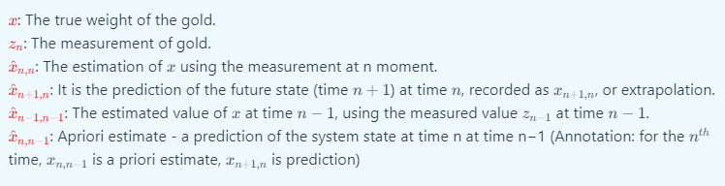
Example – Weight a Gold

Slide 9
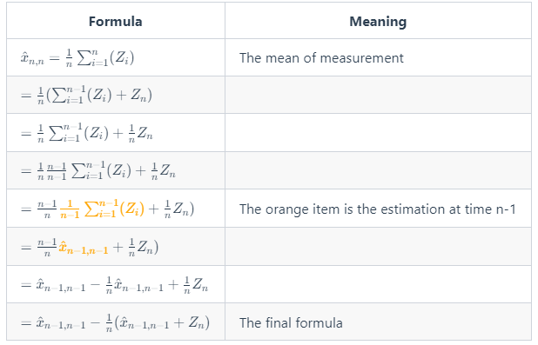
Example – Weight a Gold

Slide 10
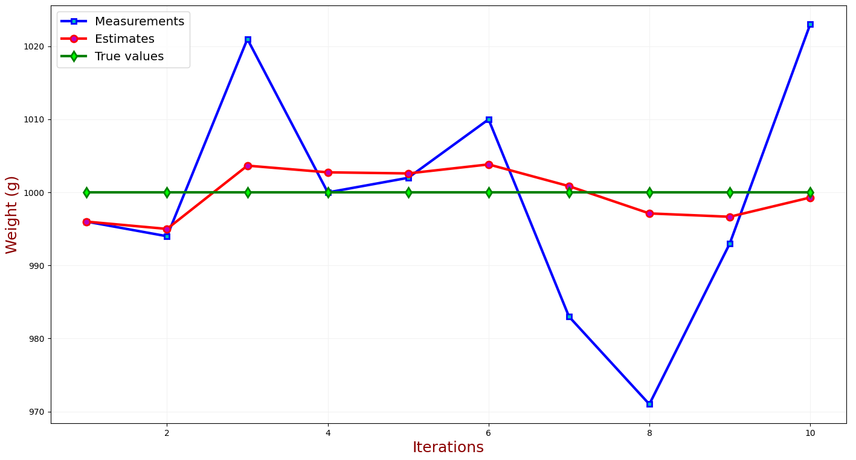
Example – Weight a Gold

Slide 11
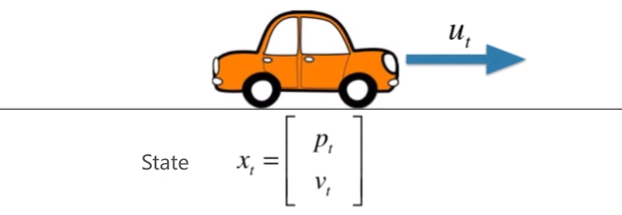
Example – Track a Car

Slide 12

Example – Track a Car

Slide 13
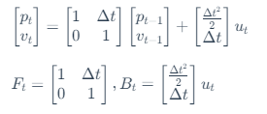

Example – Track a Car

Slide 14

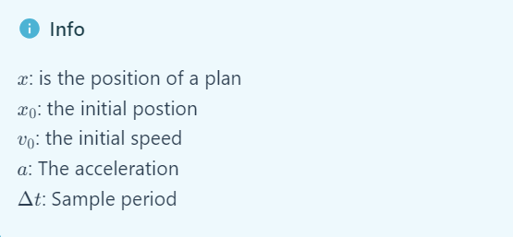
Example – Track a Car
How could we track a plan in 3 D world

Slide 15
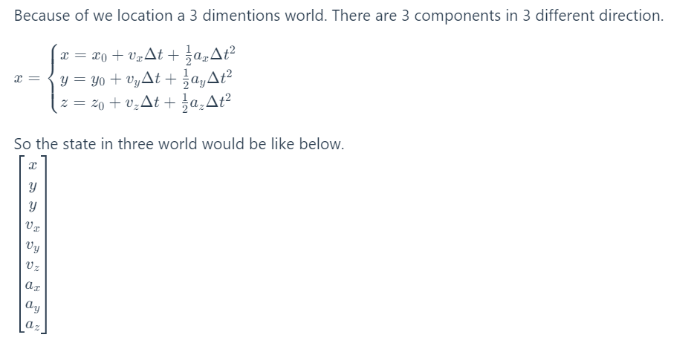
Example – Track a Car

Slide 16
The limitation

Slide 17
Conclusion
Kalman filtering is an idea, and the specific implementation depends on the specific state of the problem that needs to be described.
All the content could view on my blog: https://jet-w.github.io/unisa/2023SP5/AdvancedAnalyticTechniques1/project.html

Slide 18
References
https://www.kalmanfilter.net/CN/default_cn.aspx
https://longaspire.github.io/blog/%E5%8D%A1%E5%B0%94%E6%9B%BC%E6%BB%A4%E6%B3%A2/
https://en.wikipedia.org/wiki/Kalman_filter
https://segmentfault.com/a/1190000000514987#item-1
https://www.youtube.com/watch?v=2-lu3GNbXM8

